Slide 1



Slide 2
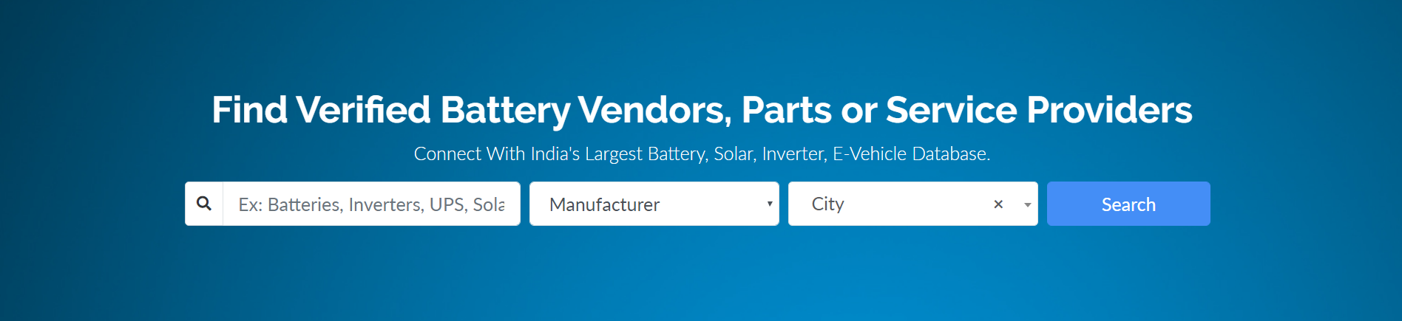
About Us
www.ebatterydirectory.com
Most businesses think that product is the most important thing, but without great leadership won't make a company successful – Robert Kiyosaki
Given the growing trend of the Internet and the advantages of Digital Marketing. Battery Directory brings to you a digital version of Battery Directory named as E Battery Directory.
E Battery Directory is the next level of Pioneer and Ever Helping Battery Directory. It is an Online Directory Portal that will help you to grow your business and increase your customer reach. Be it a small or big business or start-ups, this is an easy way to keep up with the competition.
Battery Directory is a simple way to reach new customers or to remain in reach of old customers. The objective of E Battery Directory is to increase your reach to more people in a shorter period of time.

Slide 3

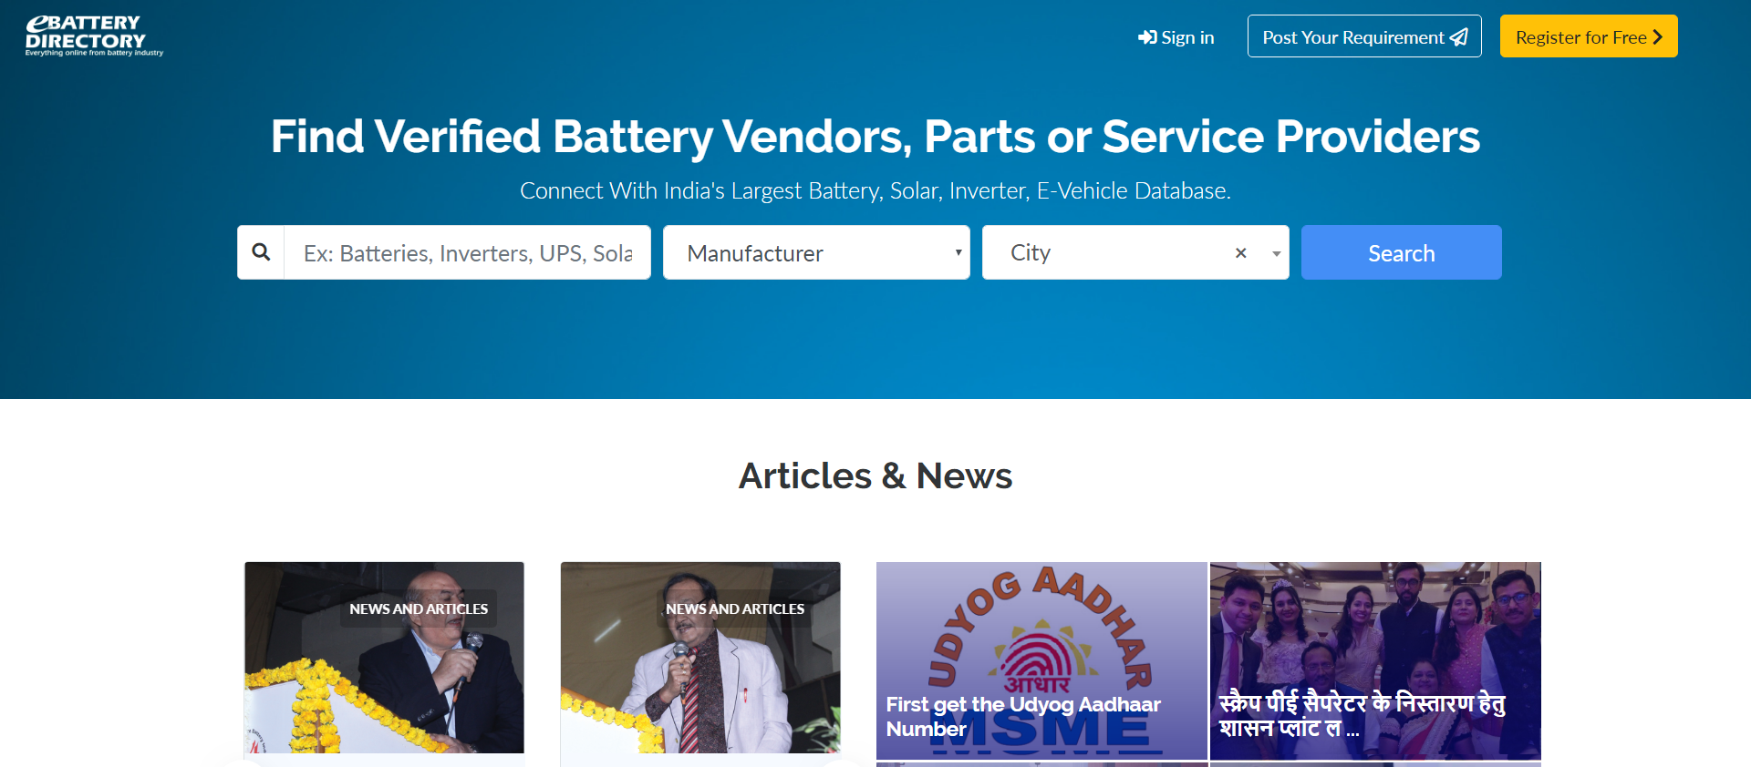
Why E Battery Directory
www.ebatterydirectory.com
By registering in E Battery Directory, you can reach out to your customer and there requirements by using our “POST YOUR REQUIRNMENT” online service.
E Battery Directory is a simple way to reach customers through digital technology. This may prove to be the quality tool for planning for the market.
E Battery Directory is one such search engine where you can get every important information about battery, solar, inverter and e-vehicle industry and can easily find a manufacturer, distributor, dealer or any service provider working in these industries.
That’s too for free.

Slide 4

Benefits
www.ebatterydirectory.com
Post Your Requirements
Latest News N Trends
You can post your custom need through this tool.
Get Updated News and information about battery industry and happing
Free Listing online
Verified Database
Register yourself and list your brands and company free.
Providing verified business details since 1985.

Slide 5

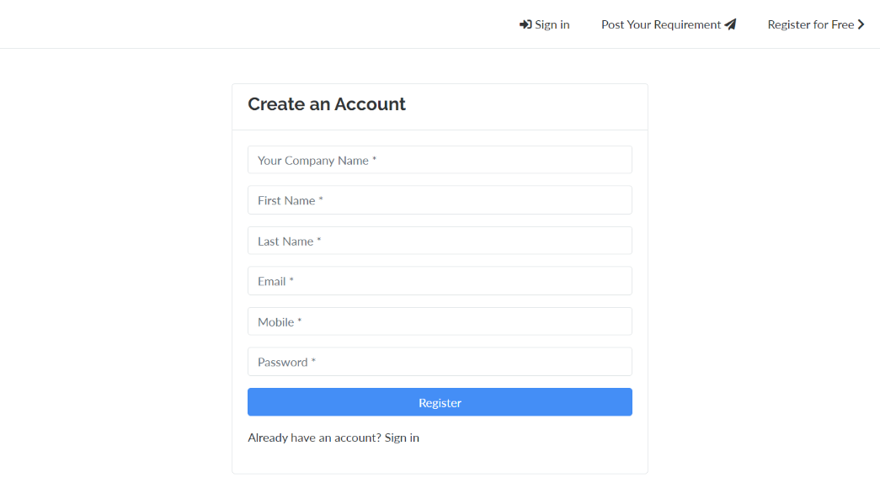
GET YOUR LISTED NOW
www.ebatterydirectory.com

Slide 6
We will not STOP ! here
www.ebatterydirectory.com
In the Second Step we will take this venture to Consumer, where Battery men can open his showroom on the web and directly sell his product to consumer. I hope that your love and blessings will strengthen us to serve the Industry as per the New Era.

Slide 7
THANK YOU
www.ebatterydirectory.com

